Slide 1
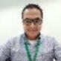



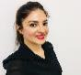

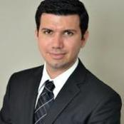
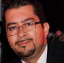






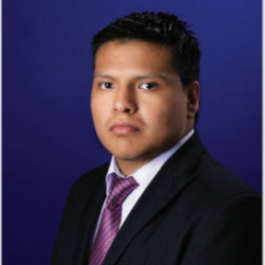
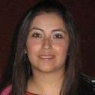
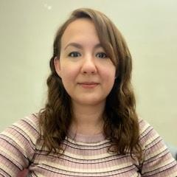


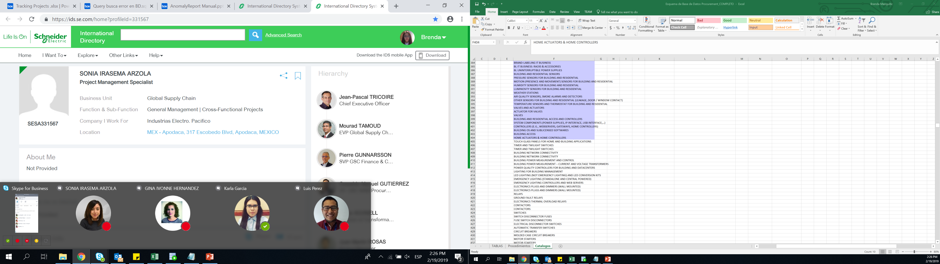
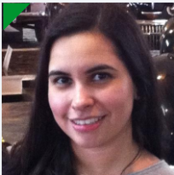


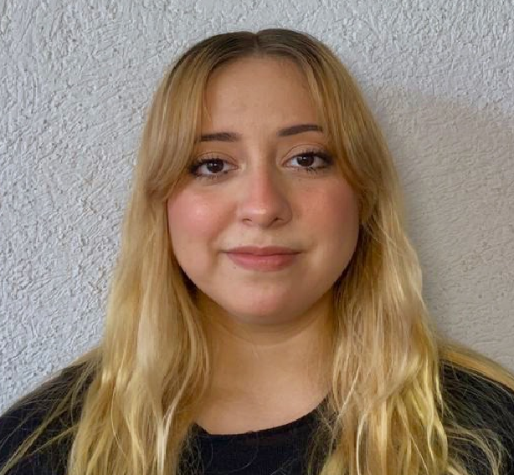
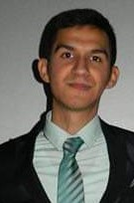





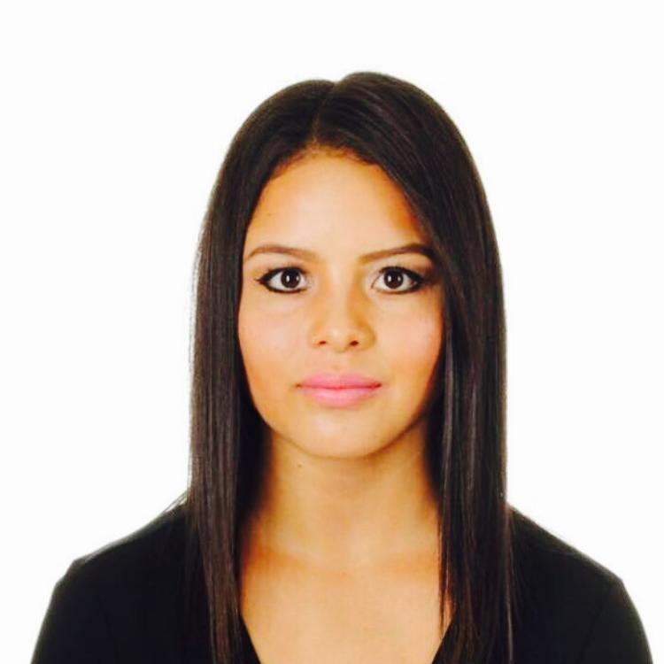
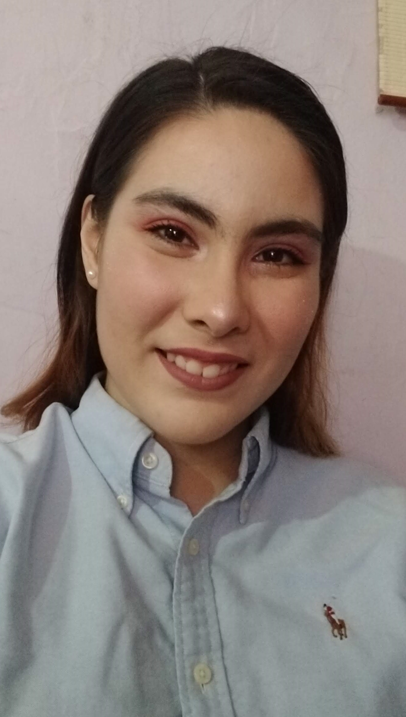
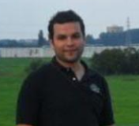
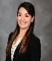



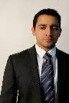

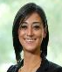











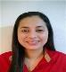



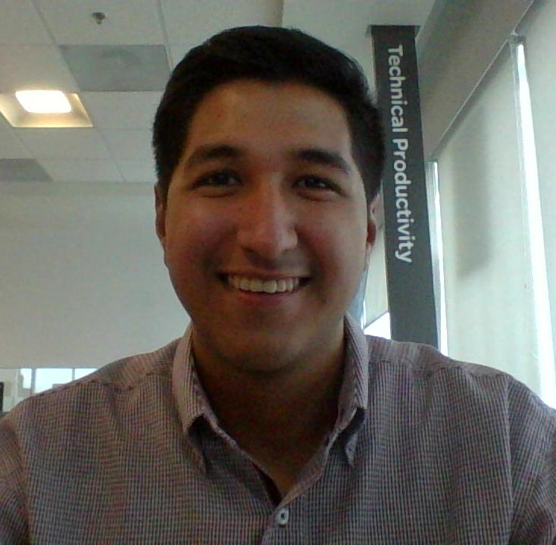




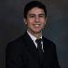




GSC NA Procurement – Transformation Organization
Horacio Galicia
Director Transformation,
MTY, MEX
Brenda Olmos
PS, MTY, MEX
Business Process Manager
Business Unit Partners
Strategic Projects & Program Management
Strategic Projects & Program Management
Juan Martin Rosas
Sr. Prj Mgr, MTY, MEX
Karthik Machiraju
Power Products, Power Systems
Erlanger, KTz
PES & MOVE administrator.
Alejandra Romero
Sr. Manager, MTY MEX
Leader PM
Jan Heinrich UDE
Sr. Manager, MTY MEX
Leader PM
Filiberto Escamilla
Home & Distribution, MTY MX
Fernando Rodriguez
Project Manager, MTY MEX
CoS (SBO-REB), QVE
Jaime Rodriguez
Project Manager, MTY MEX
CoS (SBO-REB), QVE
Carlos Galvan
Project Manager, MTY MEX
CoS (SBO-REB), QVE
Selene Galvan
Project Manager, MTY MEX
CoS (SBO-REB), QVE
Tools & Processes Mgt. Resources Coordination
Idea Generation
Idea Evolution
Armando Romero
Project Manager, MTY MEX
CoS (SBO-REB), QVE
Sonia Irasema Arzola
Project Manager, MTY MEX
CoS (SBO-REB), QVE
Nilda Ramos
Project Manager, MTY MEX
CoS (SBO-REB), QVE
Mayela Martinez
Project Manager, MTY MEX
CoS (SBO-REB), QVE
Luis Perez
IT Analyst, MTY, MEX
Web Apps Development
Ibrahim Hernandez
IT Business Partner, MTY,
IT Coordination / Web Apps
Paola Gomez
NAM Idea Program Manager,Tlax,Mex
Productivity ideas program
Raul Raygoza
MTY, MEX
Idea Evolution (Power Systems
and Home & Distribution)
Teresa Cortes
PS,MTY,MEX
Purchasing Project Specialist
Madeleine Gutierrez
Industry, Digital Energy & Secure
Power, MTY, MEX
Vanessa Lucio
Project Manager, MTY MEX
CoS (SBO-REB), QVE
Open Position
Ana Paula Aguilar
Procurement Intern,
MTY, MEX
Web Apps Development
Daniel Hernandez
Procurement Intern,
MTY, MEX
Web Apps Development
Jose Ignacio Acosta
Project Manager
Productivity Workshop
Fernando Purón
PS, MTY, MEX
Purchasing Project Specialist
Diana de la Cruz
PS MTY, MEX
Purchasing Project Specialist
Nohemi Pereira
Project Manager, MTY MEX
CoS (SBO-REB), QVE
Valdemar Berlanga
Project Manager, MTY MEX
CoS (SBO-REB), QVE
Salma Elisa Arteaga
PS, MTY, MEX
Productivity Workshop Leader
Karen Hernandez
MTY, MEX
Project Specialist Intern
Manuel Yanez
Project Manager, MTY MEX
CoS (SBO-REB), QVE
Open Position
Priscilla Rodriguez
Project Manager, MTY MEX
CoS (SBO-REB), QVE
Diego Lozano Salas
Purchasing Projects-Intern
MTY,MEX
Open Position
Purchasing Projects-Intern
Tlaxcala, Mex
Devorah Catellanos
MTY,MEX
Project Specialist Intern
Open Position
Mario Gutierrez
Project Manager, MTY MEX
CoS (SBO-REB), QVE
Jose Hernández
Purchasing Prj – Intern
MTY,MEX
Manuel Solis
PIIT CoS Engr Mgr, MTY, MEX
Prj Mgr, CoS & SBO
Lucy Casas
Supplier Quality Manager
NAM Strategic Projects
Liza Martinez
Elec-Mech Sr Eng. , PIIT MTY MEX
QVE-COS
Marco Rodriguez
Elec-Mech Engr, PIIT MTY, MEX
CoS & SBO
Lesli Rodriguez
Elec-Mech Prj Engr MTY MEX
Elena Manriquez
Elec-Mech Eng. PIITMTY, MEX
QVE & Reverse Engineering
Priscila Navarrete
Supplier Quality PM MTY ME
NAM Strategic Projects
Raul de la Rosa
Supplier Quality Engr MTY MEX
NAM Strategic Projects
Jose Luis Luna
Supplier Quality Engr TLX MEX
NAM Strategic Projects
Manuel Peinado
Elec-Mech Sr Eng.PIIT MTY, MEX CoS & SBO K5/K6
Barbara Martinez
Elec-Mech Engr, PIIT MTY, MEX
CoS & SBO
Karen Valeria Vidales
Elec.Mech Engr, PIIT MTY MEX
Hector Corpus
Mechanical Drafter, PIIT MTY MEX Design 2D 3D / Geomagic ctrl
Fatima Guzman
Supplier Quality Engr MTY MEX
NAM Strategic Projects
Nayeli Diaz
Supplier Quality Engr MTY MEX
NAM Strategic Projects
Selene Sosa Madrigal
Supply & Supplier Quality - Intern
Abraham de Leon
Mechanical Eng. PIIT MTY,MEX
CoS-Lessons Learned, SBO K1/K2
Sergio Castillo
Electronics, Prj Engr,PIIT,
MTY,MEX
Jorge Chacon
Sr Prj Elec-Mech,Rev,Eng
MTY, MEX
Jose Lopez
Mechanical Drafter, PIIT MTY MEX Design 2D 3D / Geomagic Dx
Karla Colin Renteria Supplier Quality Engr, MTY,MEX
NAM Strategic Projects
Karla Juarez
Supplier Quality Engr MTY MEX
NAM Strategic Projects
Open Position
Edgar Arredondo
Elec-Mech Sr Eng. PIIT MTY, MEX
CoS & Core Team Member
Alan Salas
Electronics, Sr Prj Engr, PIIT
MTY MEX
Mariel Puente
Sr Designer, Elec-Mech, Rev,
Eng. Geomagic, MTY, MEX
Adrian Reyes
Supplier Quality Engr MTY MEX
NAM Strategic Projects
Aldo Cardenas
Supplier Quality Engr MTY MEX
NAM Strategic Projects
Open Position
Edgar Arredondo
Elec-Mech Sr Eng. PIIT MTY, MEX
CoS & Core Team Member

Slide 2
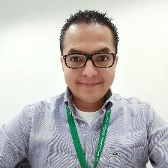


Business Unit Partners
Horacio Galicia
Director Transformation, MTY ,MEX
Karthik Machiraju
Power Products, Power Systems, Erlanger, KT
PSA and move administrator.
Madeleine Gutierrez
Industry, Digital Energy & Secure Power,
MTY,MEX
Filiberto Escamilla
E Home & Distribution,
MTY MX
Notes:
This is an example of a Text Slide. Reference the different layout options in the Slide Master (under the View tab) for different variations. Remember, our new Brand Guidelines call for clean and simple messages and design. Reference the PowerPoint Guidelines on the Brand Book for tips and useful information on creating effective presentations.

Slide 3
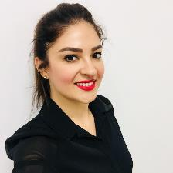

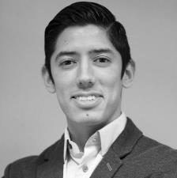
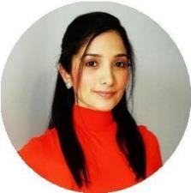
Strategic Projects & Program Management
Alejandra Romero
Sr. Manager, MTY MEX Leader PM
Fernando Rodriguez
Project Manager, TLX MEX
CoS (SBO-REB), QVE
Manuel Yanez
Project Manager, MTY MEX
CoS (SBO-REB), QVE
Valdemar Berlanga
Project Manager, MTY MEX
CoS (SBO-REB), QVE
Armando Romero
Project Manager, MTY MEX
CoS (SBO-REB), QVE
Jaime Rodriguez
Project Manager, MTY MEX
CoS (SBO-REB), QVE
Open Position
Nohemi Pereira
Project Manager, MTY MEX
CoS (SBO-REB), QVE
Sonia Irasema Arzola
Project Manager, MTY MEX
CoS (SBO-REB), QVE
Open Position
Procurement- Direct Purchasing
Intern, MTY,MEX
Notes:
This is an example of a Text Slide. Reference the different layout options in the Slide Master (under the View tab) for different variations. Remember, our new Brand Guidelines call for clean and simple messages and design. Reference the PowerPoint Guidelines on the Brand Book for tips and useful information on creating effective presentations.

Slide 4
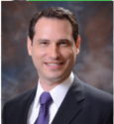
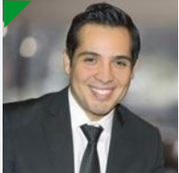

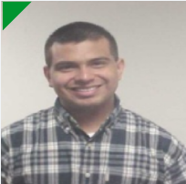
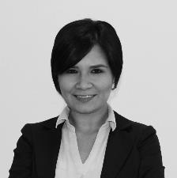
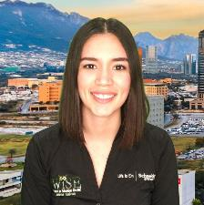
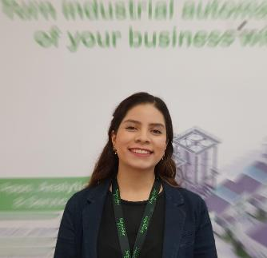

Strategic Projects & Program Management
Jan Heinrich UDE
Sr. Manager, MTY MEX Leader PM
Carlos Galvan
Project Manager, MTY MEX
CoS (SBO-REB), QVE
Priscilla Rodriguez
Project Manager, MTY MEX
CoS (SBO-REB), QVE
Jose Hernández
Purchasing Projects – Intern
MTY MEX
Nilda Ramos
Project Manager, MTY MEX
CoS (SBO-REB), QVE
Mario Gutierrez
Project Manager, MTY MEX
CoS (SBO-REB), QVE
Diego Lozano Salas
Purchasing Projects-Intern
MTY MEX
Vanessa Lucio
Project Manager, MTY MEX
CoS (SBO-REB), QVE
Selene Galvan
Project Manager, MTY MEX
CoS (SBO-REB), QVE
Open Position
Mayela Martinez
Project Manager, MTY MEX
CoS (SBO-REB), QVE
Osvaldo Balboa
Project Manager, MTY MEX
CoS (SBO-REB), QVE
Notes:
This is an example of a Text Slide. Reference the different layout options in the Slide Master (under the View tab) for different variations. Remember, our new Brand Guidelines call for clean and simple messages and design. Reference the PowerPoint Guidelines on the Brand Book for tips and useful information on creating effective presentations.

Slide 5
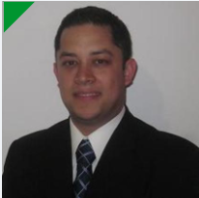
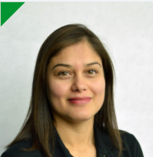
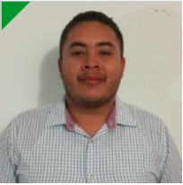
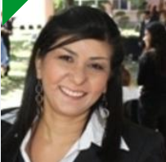

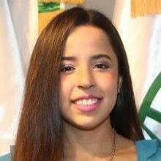

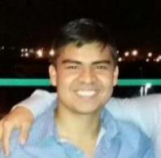


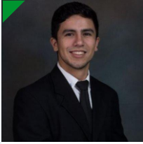
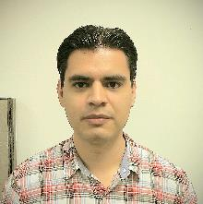
Project Engineers
Manuel Solis
PIIT CoS Engr Mgr, MTY, MEX
Prj Mgr, CoS & SBO
Liza Martinez
Elec-Mech Sr Eng. PIIT MTY, MEX
QVE-COS
Marco Rodriguez
Elec-Mech Engr, PIIT MTY, MEX
CoS & SBO
Lesli Rodriguez
Elec-Mech Prj Engr MTY MEX
Elena Manriquez
Elec-Mech Eng. PIIT MTY, MEX
QVE & Reverse Engineering
Manuel Peinado
Elec-Mech Sr Eng.PIIT MTY, MEX CoS & SBO K5/K6
Barbara Martinez
Elec-Mech Engr, PIIT MTY, MEX
CoS & SBO
Karen Valeria Vidales
Elec.Mech Engr, PIIT MTY MEX
Hector Corpus
Mechanical Drafter, PIIT MTY MEX
Design 2D 3D / Geomagic ctrl
Abraham de Leon
Mechanical Eng. PIIT MTY,MEX CoS-Lessons Learned, SBO K1/K2
Sergio Castillo
Electronics, Prj Engr, PIIT MTY MEX MEX
Jorge Chacon
Sr Prj Elec-Mech,Rev,Eng MEX MTY, MEX
Jose Lopez
Mechanical Drafter, PIIT MTY MEX Design 2D 3D / Geomagic Dx
Edgar Arredondo
Elec-Mech Sr Eng. PIIT MTY, MEX
CoS & Core Team Member
Alan Salas
Electronics, Sr Prj Engr, PIIT
MTY MEX
Mariel Puente
Sr Designer, Elec-Mech, Rev,
Eng. Geomagic, MTY, MEX

Slide 6


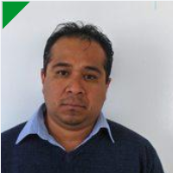


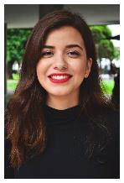
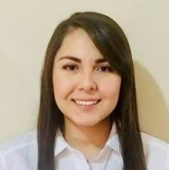
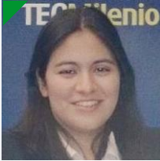

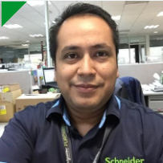
Supplier Quality & Logistics – Strategic Projects SQLD Team
Lucy Casas
Supplier Quality Manager
NAM Strategic Projects
Priscila Navarrete
Supplier Quality PM MTY MEX NAM Strategic Projects
Raul de la ROSA
Supplier Quality Engr MTY MEX NAM Strategic Projects
Jose Luis Luna
Supplier Quality Engr TLX MEX NAM Strategic Projects
Fatima Guzman
Supplier Quality Engr MTY MEX NAM Strategic Projects
Nayeli Diaz
Supplier Quality Engr MTY MEX NAM Strategic Projects
Selene Sosa Madrigal Supply & Supplier Quality - Intern, MTY, MEX
Karla Colin Renteria
Supplier Quality Engr, MTY,MEX
NAM Strategic Projects
Karla Juarez
Supplier Quality Engr MTY MEX NAM Strategic Projects
Open Position
Adrian Reyes Supplier Quality Engr MTY MEX NAM Strategic Projects
Aldo Cardenas
Supplier Quality Engr MTY MEX NAM Strategic Projects
Open Position
Notes:
This is an example of a Text Slide. Reference the different layout options in the Slide Master (under the View tab) for different variations. Remember, our new Brand Guidelines call for clean and simple messages and design. Reference the PowerPoint Guidelines on the Brand Book for tips and useful information on creating effective presentations.

Slide 7

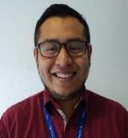

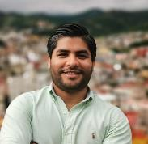
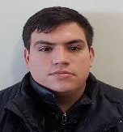

Tools Process Mgt, Resource Coordination & Idea Generation & Evolution
Juan Martin Rosas
Procurement Sr Program Mgr, MTY, MEX
Tools & Processes Mgt. Resources Coordination
Idea Generation
Idea Evolution
Paola Gomez
NAM Idea Program Manager,Tlax, Mex
Productivity ideas program
Raul Raygoza
Prj Specialist MTY, MEX
Idea Evolution(Power Systems, Home&Distriution)
Teresa Cortes
Prj Specialist MTY, MEX Purchasing Project Specialist
Luis Perez
IT Analyst, MTY, MEX
Web Apps Development
Ibrahim Hernandez
IT Business Partner, MTY, MEX
IT Coordination / Web Apps Dev
Jose Ignacio Acosta
Project Manager, MTY,MEX
Productivity Workshop
Fernando Purón
Prj Specialist MTY, MEX
Purchasing Project Specialist
Diana de la Cruz
Prj Specialist MTY, MEX
Purchasing Project Specialist
Ana Paula Aguilar
Procurement Intern,
MTY, MEX
Web Apps Development
Daniel Hernandez
Procurement Intern,
MTY, MEX
Web Apps Development
Salma Elisa Arteaga
Productivity Workshop MTY, MEX
Idea Evolution (Home & Distribution, PP)
Karen Hernandez
MTY, MEX
Project Specialist Intern
Open Position
Purchasing Projects-Intern
Tlaxcala, Mex
Open Position
Project Specialist Intern, MTY,MEX

Slide 8







Project Mgr.'s By Category (SBO-REB)
K1/B1
K3/A1
D2/M2/Others
P1/C1/C2/K1
G3/G4/G8
K5/K6/K7
Carlos Galvan
Project Manager, MTY MEX
CoS (SBO-REB), QVE
Nohemi Pereira
Project Manager, MTY MEX
CoS (SBO-REB), QVE
Selene Galvan
Project Manager, MTY MEX
CoS (SBO-REB), QVE
Nilda Ramos
Project Manager, MTY MEX
CoS (SBO-REB), QVE
Osvaldo Balboa
Project Manager, MTY MEX
CoS (SBO-REB), QVE
Fernando Rodriguez
Project Manager, TLX MEX
CoS (SBO-REB), QVE
Manuel Yanez
Project Manager, MTY MEX
CoS (SBO-REB), QVE
Open Position
Project Manager
CoS (SBO-REB), QVE
Open Position
Project Manager, MTY MEX
CoS (SBO-REB), QVE
Mario Gutierrez
Project Manager, MTY MEX
CoS (SBO-REB), QVE
Sonia Irasema Arzola
Project Manager, MTY MEX
CoS (SBO-REB), QVE
Vanessa Lucio
Project Manager, MTY MEX
CoS (SBO-REB), QVE
Open Position
Project Manager, MTY MEX
CoS (SBO-REB), QVE
Open Position
Project Manager
CoS (SBO-REB), QVE
Valdemar Berlanga
Project Manager, MTY MEX
CoS (SBO-REB), QVE
Armando Romero
Project Manager, MTY MEX
CoS (SBO-REB), QVE
Open Position
Project Manager, MO USA
CoS (SBO-REB), QVE

